Slide 1
HKEX Chatbook
Insights via data
Edition 1, June 2023

Slide 2
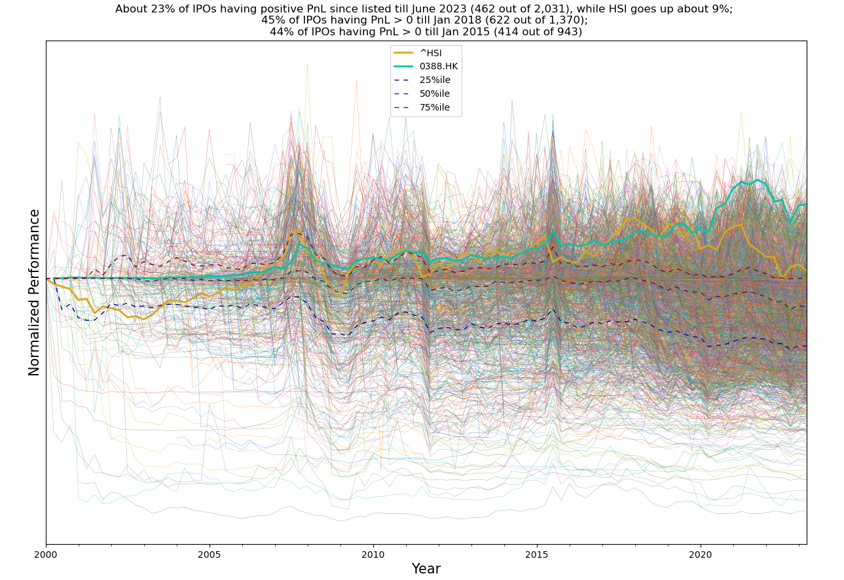
Do investors make money on HK stocks?
Looking at about all 2,000 IPOs since 2000 at HKEX
Source: hkex.com.hk, Bloomberg and Yahoo finance from Jan 2000 to Jun 2023

Slide 3
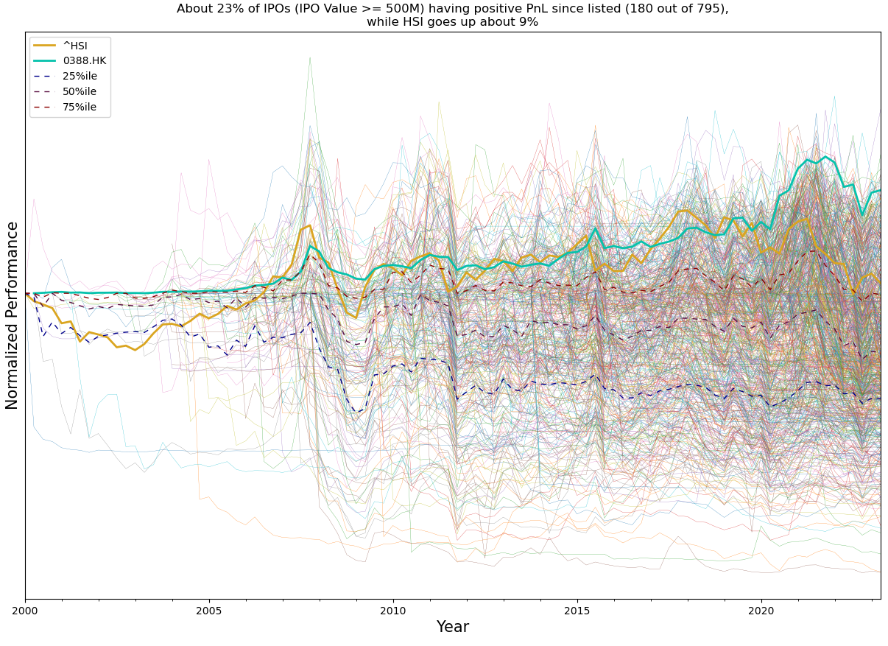
Do investors make money on HK stocks?
Looking at about 800 IPOs with value >= HKD 500Mn since 2000 at HKEX
Source: hkex.com.hk, Bloomberg and Yahoo finance from Jan 2000 to Jun 2023

Slide 4
Do investors make money on HK stocks?
If invested in the market on any day in the past 20 years, how the IRR would be like:
Source: Yahoo finance data from Jan 2000 to Dec 2022, as IRR of Jun 16, 2023

Slide 5
Where does our ADT come from?
By vintage:
Source: Yahoo finance data from Jan 2000 to Jun 2023

Slide 6
Where does our ADT come from?
By sector:
Source: Yahoo finance data from Jan 2000 to Jun 2023
* New economy: Hang Seng Index New Economy sectors

Slide 7
Is our market liquid?
ADT distribution by percentile of Market Cap
10%
20%
30%
40%
50%
60%
70%
80%
90%
100%
Source: Yahoo finance for 6-mth period from Jan 2023 to Jun 2023, incl. all Main, GEM, STAR, ChiNext stocks / shares and ADSs

Slide 8
Is our market liquid?
ADT distribution by percentile of Market Cap
10%
20%
30%
40%
50%
60%
70%
80%
90%
100%
Source: Yahoo finance for 6-mth period from Jan 2023 to Jun 2023, incl. all Main, GEM, STAR, ChiNext stocks / shares and ADSs

Slide 9
Appendix

Slide 10
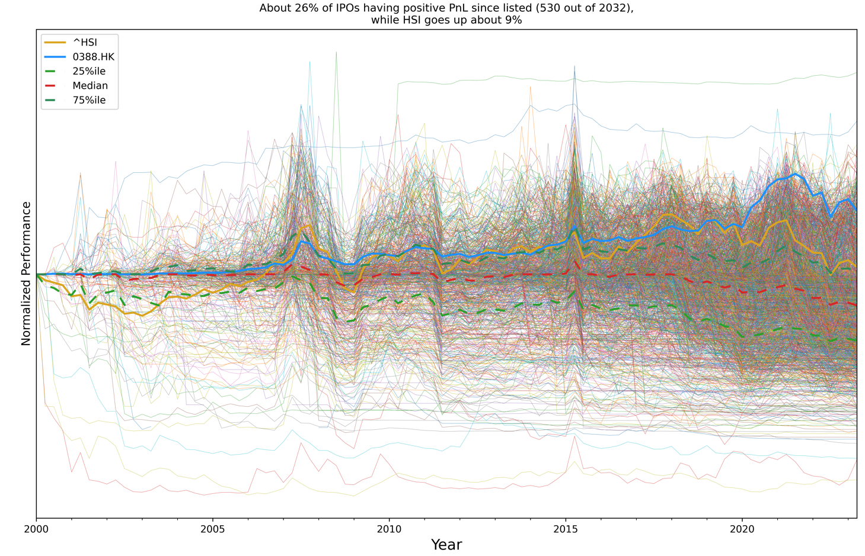
Do investors make money on HK stocks?
Looking at about all 2,000 IPOs since 2000 at HKEX, starting from first-day close
Source: hkex.com.hk and Yahoo finance from Jan 2000 to Jun 2023

Slide 11
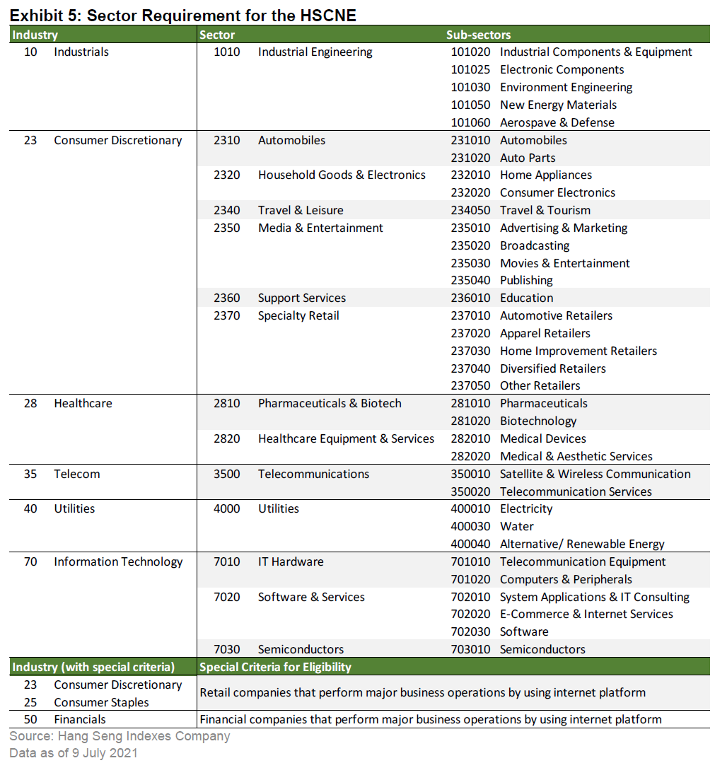
Where does our ADT come from?
Economy sectors in Hang Seng Index
Source: https://www.hsi.com.hk/static/uploads/contents/en/dl_centre/blog/20210716T000000.pdf

